Slide 1
Inheritance, Polymorphism and the Object Memory Model

Slide 2
how objects are stored in memory at runtime?
compiler - operations such as access to a member of an object are compiled
runtime - implementation of operations such as new and delete

Slide 3
Object-class in memory
object= instance of a class
class defines characteristics of instances: data members (state)/member functions (methods).
object is implemented at runtime as a region of storage (a contiguous block of memory)
class defines the memory layout of all the objects that belong to that class

Slide 4
Object-class in memory
object of class is allocated a copy of all class data members
static members allocated once
objects of class share member functions (methods)
code for functions is stored only once in memory for each class.

Slide 5
object values / object references
object references is as a pointer to an object value
object values are implemented as a contiguous block of memory, where each field (data member) is stored in sequence

Slide 6
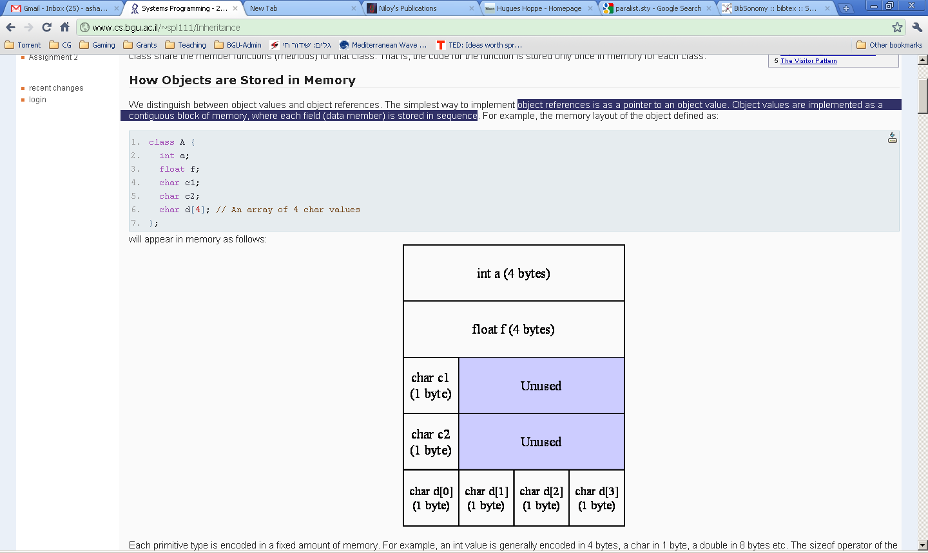

Slide 7
sizeof()
primitive type is encoded in a fixed amount of memory.
int 4 bytes, char 1 byte, double 8 bytes… etc.
sizeof() - size used by a given type.
computed at compile-time
a compiler operator
can return size allocated for object data-types
sizeof(A) = 20 (5 words of 4 bytes).

Slide 8
Field Alignment
fields c1 and c2 are "word aligned" within the block of memory of the object:
fields start on a word boundary (word=4b)
memory left "wasted"
compiler flag not to align fields
aligning fields - easy data accessing

Slide 9
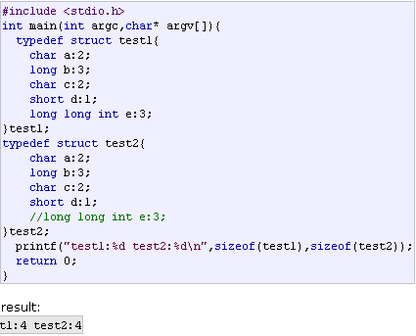
Bitfields should be avoided

Slide 10
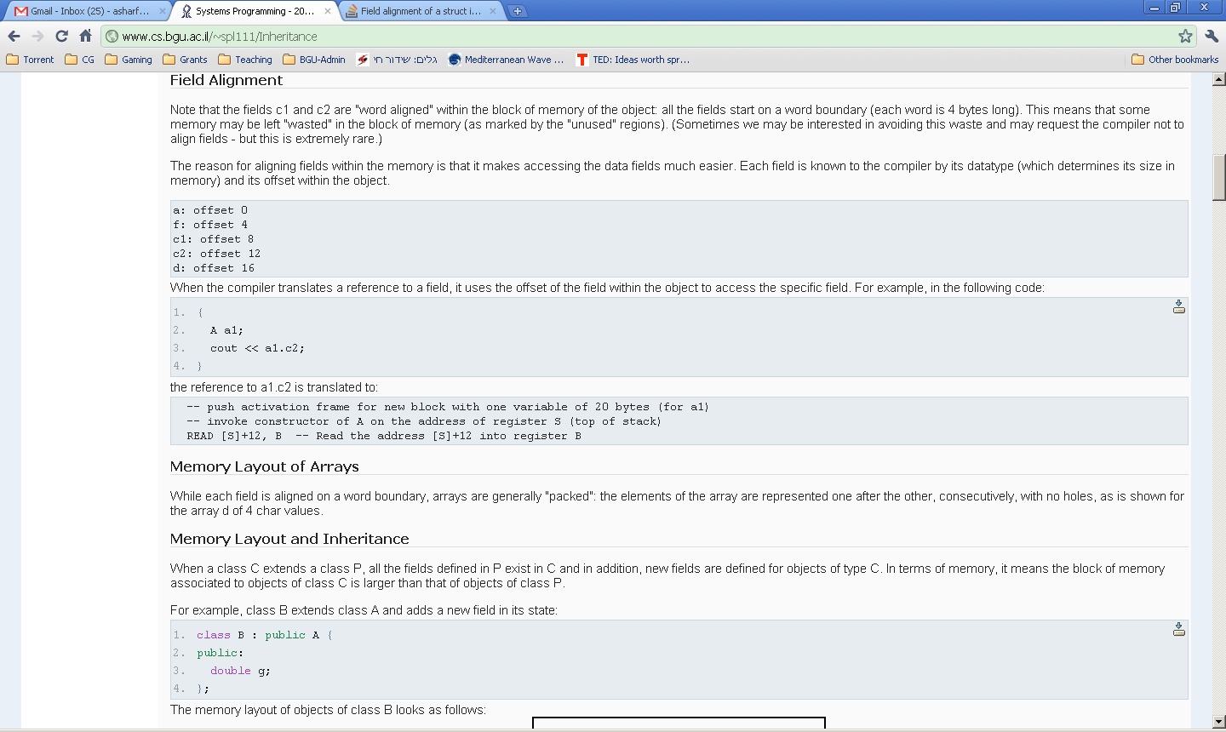

Slide 11
reference to a field - compiler uses offset of field within the object
a1.c2 is translated to:
push activation frame for new block with one variable of 20 bytes (for a1)
invoke constructor of A on the address of register S (top of stack)
READ [S]+12, B - address [S]+12 into register B

Slide 12
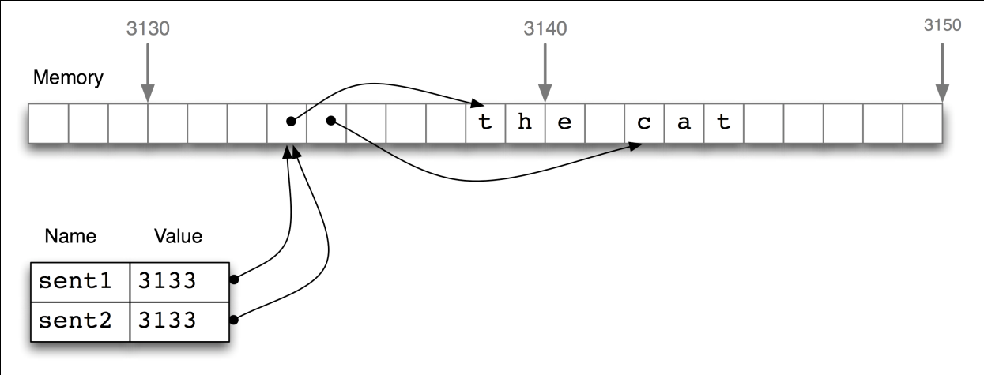
Memory Layout of Arrays
field is aligned on a word boundary
arrays are generally "packed": elements of array are one after the other
no holes
char *str = “the cat”;

Slide 13
Memory Layout and Inheritance
class B extends class A
fields defined in A exist in B
new fields for objects of type B.
block memory for objects of class B is larger than that of objects of class A.

Slide 14
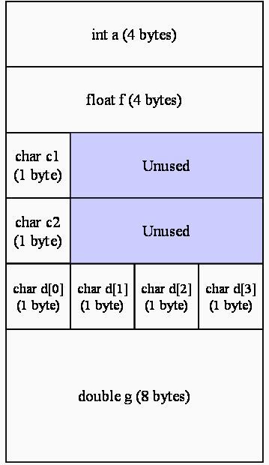
first 20 bytes = structure of type A.
"look at a B value“ as if an "A value":
take first part of B and "cut" to sizeof(A).

Slide 15
C++ and memory
code for the methods of a class is stored only once for each class
picture of the memory allocated to a process covers 3 distinct areas:
heap: values allocated using the new operator
stack: automatic values in activation frames
code segment: code of all the classes used in the program executed by the process

Slide 16
abstract objects & memory model
an abstract object is characterized by the following elements:
identity
state
set of objects it knows
interface (set of messages to which the object can react)

Slide 17
abstract objects & memory model
identity - address of object data in memory
state of object - encoded in associated memory block (fields values)
interface of object - known by the compiler, based on type of object
methods for objects to react (defined by class)

Slide 18
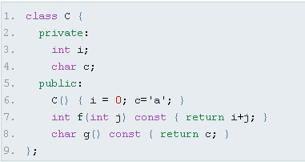
interface: C::C(), C::~C(), C::f(), C::g()

Slide 19
code region
method is stored in code region allocated to process in which the class is used
method is encoded as sequence of processor instructions
method is known to compiler by start address in memory
invocation of method = sequence of instructions:
parameters pushed on stack
method invoked by using CALL instruction of the processor
passed the address of the first instruction of the method that is invoked.

Slide 20
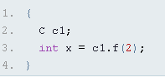
push new activation frame on stack - c1= 8B + x=4B
invoke C::C() on the address [S]
push [S] -- push the address of c1 on the stack
push $2 -- push the constant 2 on the stack
push [S] -- push the address of c1 on the stack
call [C::f] -- invoke c1.f(2)
write ReturnRegister [S-4] -- copy the value returned by f into variable x which is below c1 in the stack
pop [S] – pop the address of c1 from stack
call [C::~C] -- invoke the destructor of c1

Slide 21
compiler maintains internal table where it keeps track of the address of each of the methods of the class
compiler invokes a method of a class
method has access to internal state of object, wherever it may be. How?

Slide 22
implicit "this" parameter
How method knows where are fields of object?
Solution: compiler always passes a "hidden" parameter to method call: address of the object-this
this of type C* (for class C): address of block organized according to structure of class C.

Slide 23
Static method
static methods do not have access to this - can be invoked independently
C::static_method(x)

Slide 24
Polymorphism
ability to use an operator or function in different ways.
Different meanings to the operators or functions (poly = many / morph = shape)
6+5
“a”+”bc”
3.2+4.75

Slide 25
Late Binding
Polymorphism = essential property of OO languages
Refers to the possibility to decide which method to invoke at runtime and not at compile time.

Slide 26
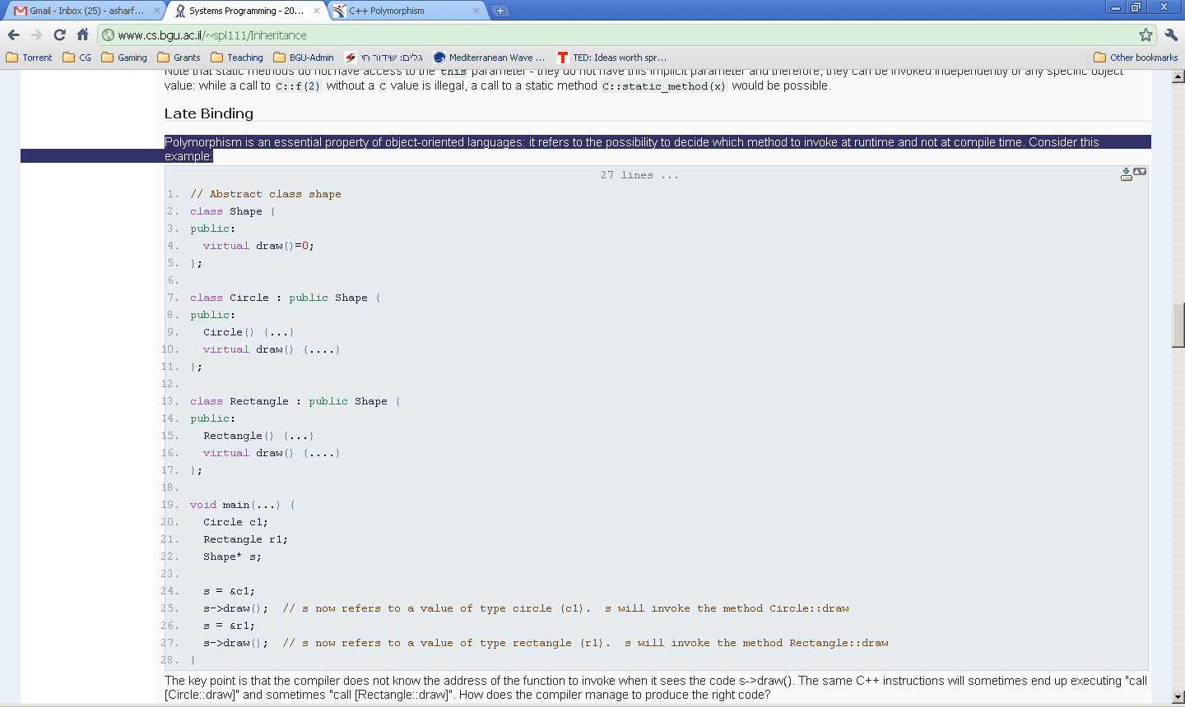

Slide 27
s->draw()
compiler does not know the address of the function to invoke
same C++ instruction will sometimes execute:
"call [Circle::draw]"
"call [Rectangle::draw]"
How does the compiler manage to produce the right code?

Slide 28
Vtable Mechanism
compiler delaying the decision of method to invoke to runtime, instead of compile time.
method is marked as virtual
actual method invoked depends on the type of the value of the object at runtime
not on the type of the value at compile time

Slide 29
s is a variable of type Shape
invoke s->draw():
Call draw() of Rectangle or Circle by value to which s is bound at time of invocation

Slide 30
virtual-table (vtable)
how an object decides which code to invoke when it receives a message?
message = invocation of a method through a pointer to an object.
value of object in memory is extended by a pointer to a table with function address
table is stored explicitly in process memory (code region).
table for each class that contains virtual methods.

Slide 31
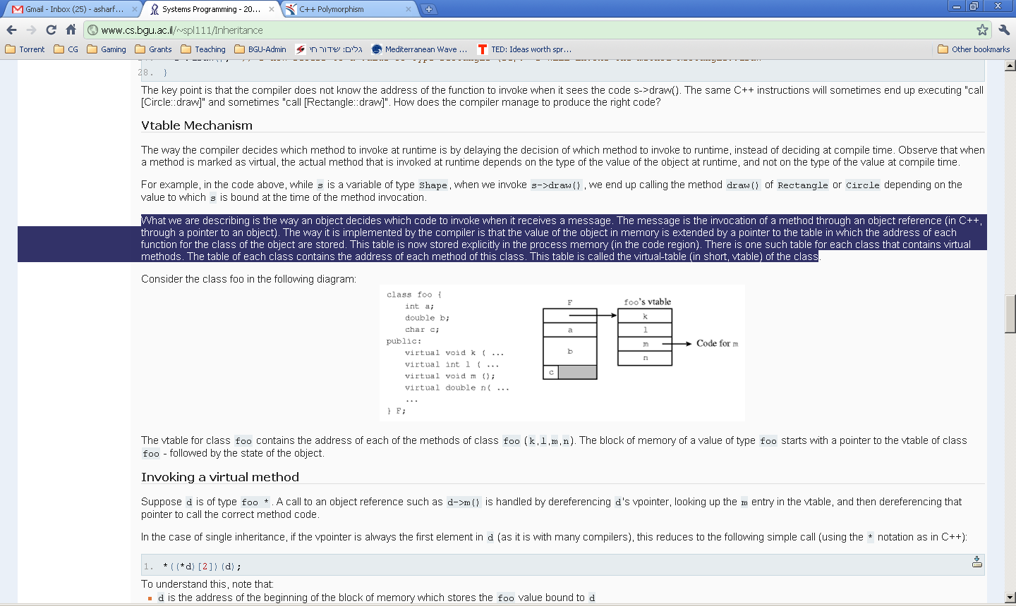
vtable for class foo

Slide 32
Invoking a virtual method
Suppose d is of type foo *.
call to object reference: d->m():
dereferencing d's vpointer,
looking up the m entry in the vtable,
dereferencing that pointer to call the correct method code.

Slide 33
Example: *((*d)[2])(d);
Assume vpointer is always the first element in d:
d is the address of the beginning of the block of memory which stores the foo value bound to d
*d is the content of the first word in the block of memory: it contains the address of the vtable
(*d)[2] is the address of the 3rd element in the vtable (the address of method m)
*((*d)[2])(d) - invoke function located at third slot in vtable of foo and pass to it the address of the value

Slide 34
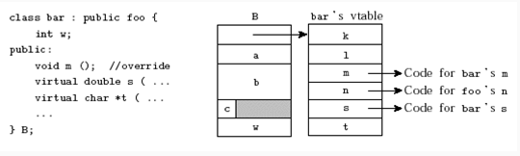
Inheritance and vtable
When a class extends another class, how is the vtable managed?
bar extends foo. bar overrides m, and introduces 2 new methods s and t.

Slide 35
compiler generates a new distinct vtable for class bar. vtable elements point:
to same addresses as parent when method is not overridden
overridden methods or to the new methods otherwise
vtable of inherited class is an extension of the vtable of the parent table:
shared methods appear in the same order
new methods in the child class appear at the end of the vtable.

Slide 36
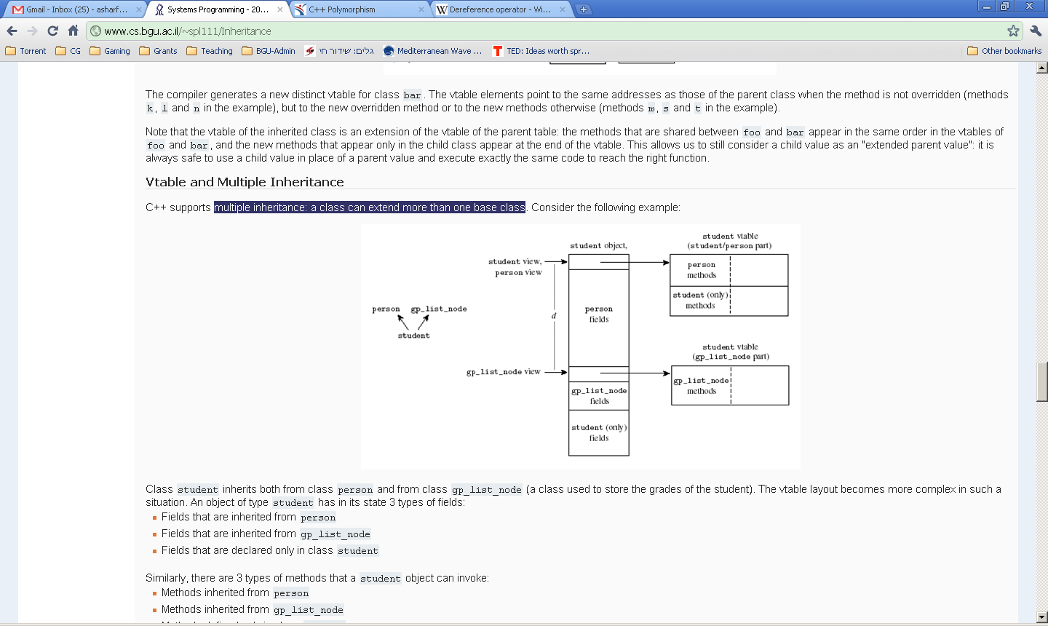
Vtable and Multiple Inheritance
multiple inheritance: a class can extend more than one base class

Slide 37
Multiple Inheritance
Class student inherits both from class person and from class gp_list_node
vtable layout becomes more complex in such a situation.

Slide 38
Multiple Inheritance
object of type student has in its state 3 types of fields (inherited from person, gp_list_node) and declared in class student
3 types of methods (inherited from person, gp_list_node) and defined in class student

Slide 39
Vtable
vtable points to student specific vtable
vtable first contains person methods, next methods that appear in class student
vtable is then followed by the person fields. (look at a student value as a person value - just ignore the bottom part of the block)
we cannot store the gp_list_node vtable at the beginning of the block.

Slide 40
So where can we store gp_list_node vtable?
Store fields right after the person fields.
Store gp_list_node data members after this vtable
Finally we store the student specific data members at the end of the data block

Slide 42
how does the compiler find the appropriate vtable?
how to pass valid this pointer to a method of gp_list_node that is not overridden?
code cannot know that what it receives as a this pointer is not a real gp_list_node.
accesses the fields of the value it has assuming it is a gp_list_node value.

Slide 43
pointer fixup
compiler knows what type of method is invoked - either inherited from person, gp_list_node or specific to student.
If inherited from gp_list_node: pass "corrected address" (this+d, d=sizeof(person)).
look down from this address, block memory looks as a valid gp_list_node value
vtable to which we point is also a valid gp_list_node vtable

Slide 44
Casting and Addresses
when we cast an object to a different class, we may end up with a different address in memory
casting is not only to tell the compiler "trust me I know what I do"; it also can end up generating code to fix the pointers in memory.

Slide 45
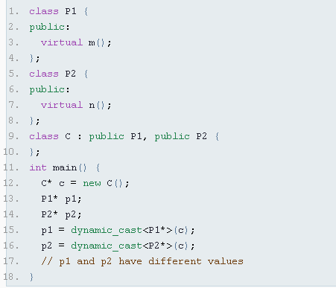

Slide 46
Implicit conversion:
short a=2000; int b; b=a;
automatically performed when a value is copied to a compatible type
Explicit conversion
short a=2000; int b; b = (int) a;
explicit type-casting allows to convert any pointer into any other pointer type

Slide 47
Dynamic_cast:
can be used only with pointers and references
ensure that the result of the type conversion is a valid complete object
always successful when we cast a class to one of its base classes
Compatibility: dynamic_cast requires the Run-Time Type Information (RTTI) to keep track of dynamic types

Slide 48
g++ fdump -class-hierarchy option
look at the exact structure of the vtables the compiler generates for us
g++ has an option that allows us to get this information in a readable manner:
g++ c.cpp -fdump-class-hierarchy -o c
generates a text file called c.cpp.t01.class which
gives the details of the memory layout and vtable of the classes defined in the file.

Slide 49
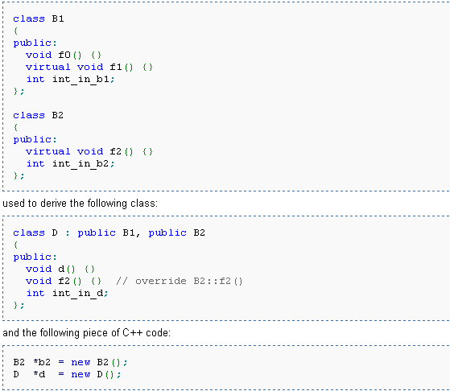

Slide 50
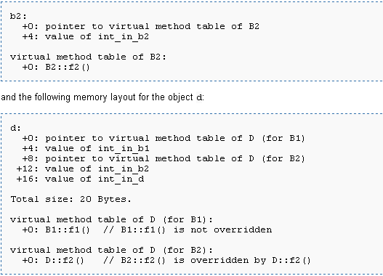

Slide 51
Virtual methods: performance issues
invoking a virtual method is more expensive at runtime than invoking a regular function.
2 operations: get the location of the function's code from vtable, and invoke the function.
2 other costs to the vtable mechanism:
Object values are extended by one word for each vtable to which they refer.
Virtual methods cannot be compiled "inline"
(Inline: avoids calling a function - pushing arguments on the stack, popping them out at end - copying code of the function at invocation)

Slide 52
3 costs combined can have a strong effect on performance of program.
in C++, methods are not virtual by default. If a class does not have virtual method, then does not include a vtable.
in Java, methods are always virtual.

Slide 53
Implementing Interfaces in C++
Java avoids the complexity of multiple inheritance
restricts programmers to single inheritance and the mechanism of interfaces.
Interfaces = restricted method of multiple inheritance.
interfaces in C++: pure virtual abstract class.

Slide 54
pure virtual abstract class
does not define any data members.
All of its methods are virtual.
All of its methods are abstract (marked in C++ as virtual m() = 0;)

Slide 55
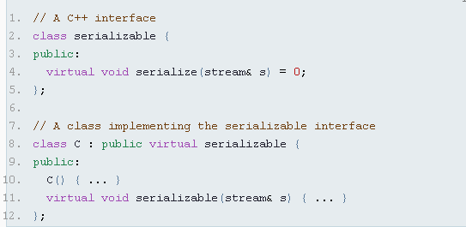
"virtual inheritance“= "implement an interface"
avoid the problem of ambiguous hierarchy composition – diamond problem
inheritance=arranging classes in memory

Slide 56
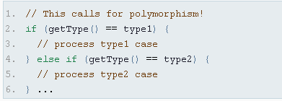
The Visitor Pattern
when you want to decide at runtime which piece of logic to execute=polymorphism
In such cases in your code -refactor -introduce polymorphism

Slide 57
Visitor pattern - achieve re-organization of your code
a Printer object can print Document objects.
code to print documents types is different
code for each type of printer is different.
“double dispatch”

Slide 58
use the virtual table dispatch mechanism to send the print message to the right method.
a printer object receives the print message with a document object:
first dispatch happens when we select the appropriate printer object
second dispatch (based on the type of document) is achieved by sending the printMe message to the document.
e.

Slide 59
do not want each document class to know about each printer class –very bad coupling.
document object just invokes the specific printer method on a specific document type method.
each document type for each printer type has a separate method handling the specific code

Slide 60
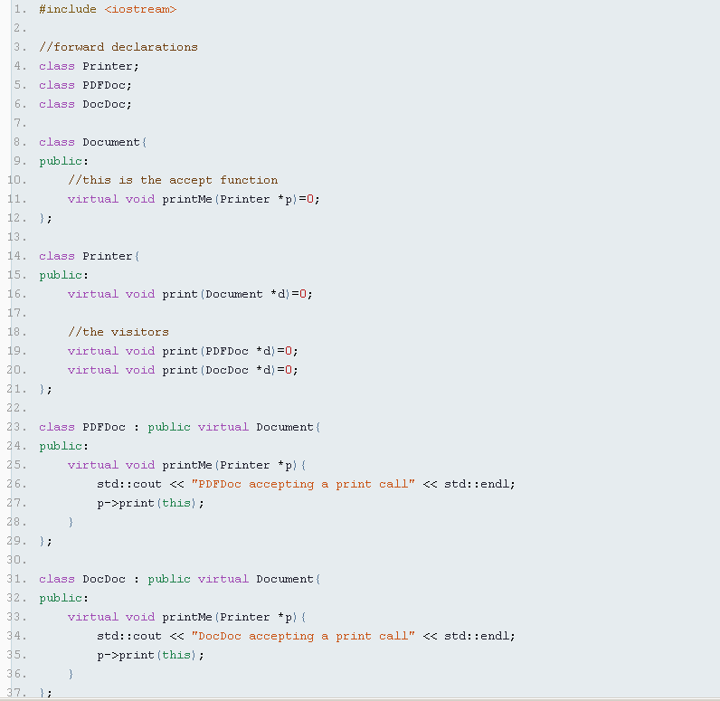

Slide 61
